Slide 1
Demo 1 Docker Basics & Docker Hub

Slide 2
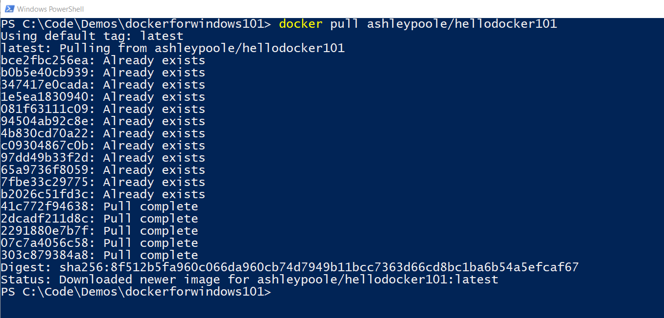

Slide 3
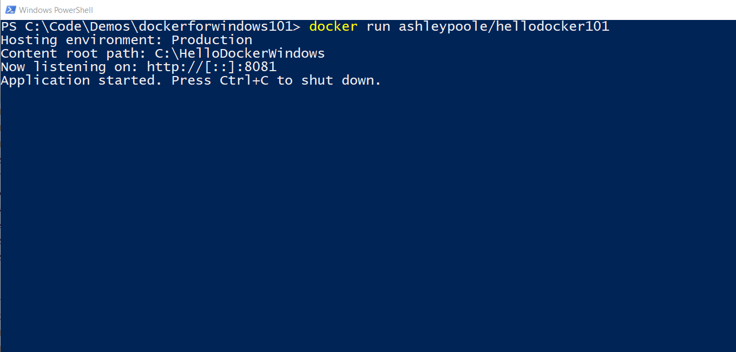

Slide 4
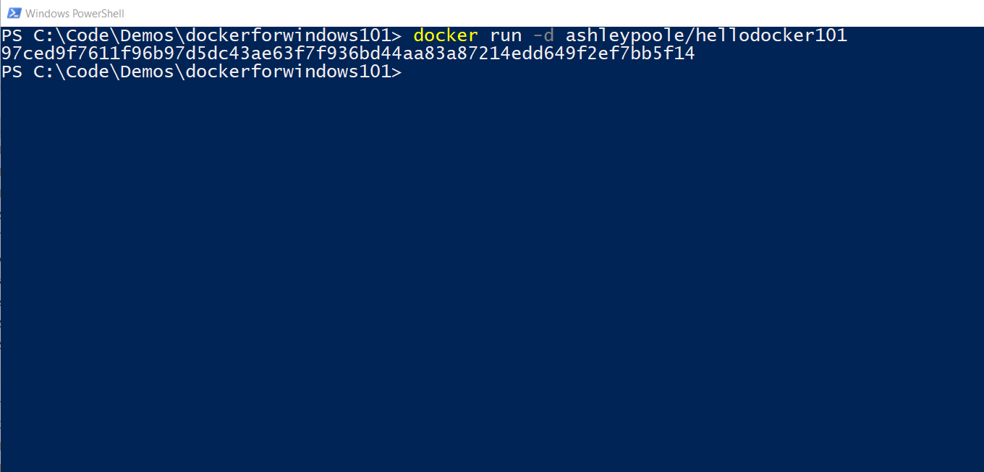

Slide 5
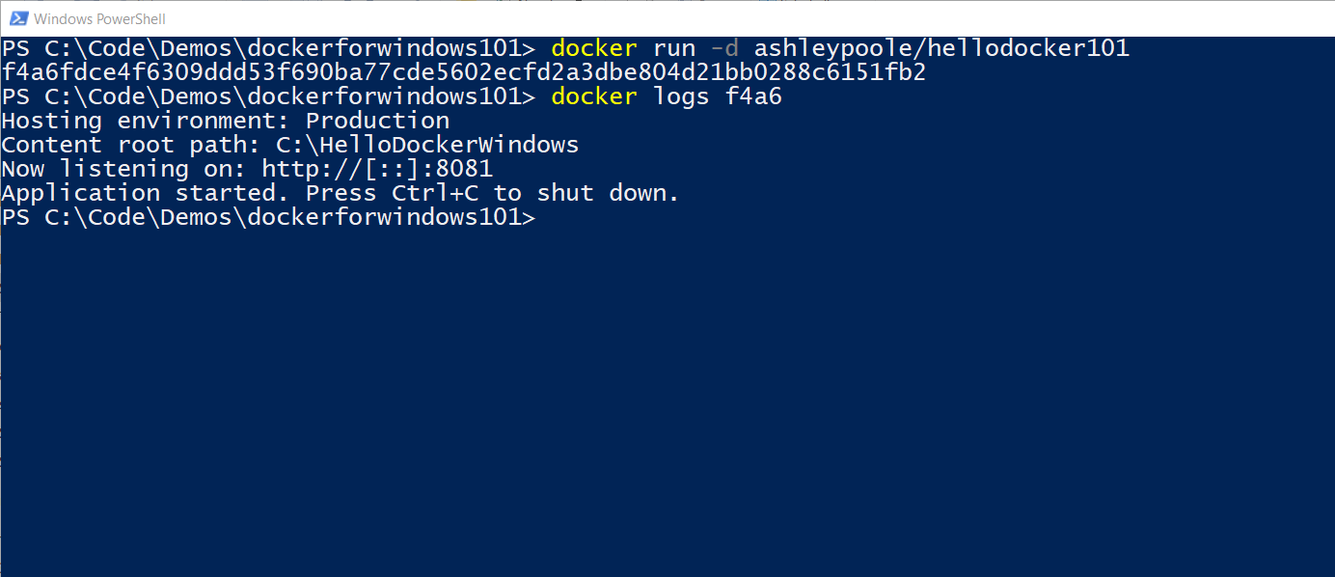

Slide 6
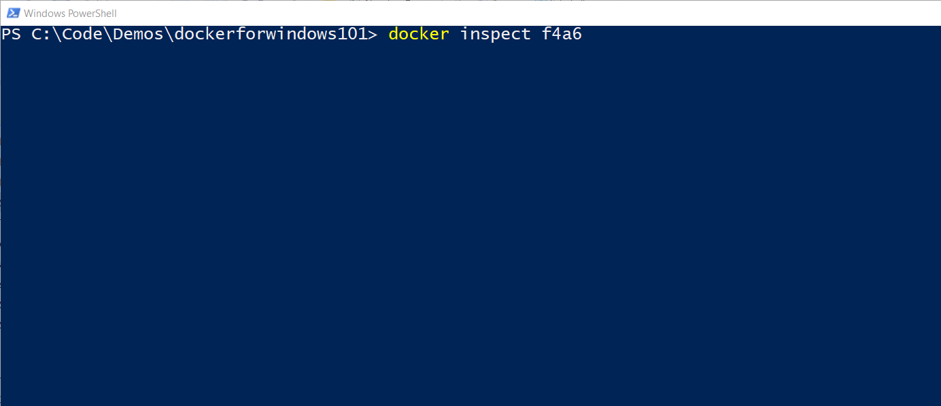

Slide 7
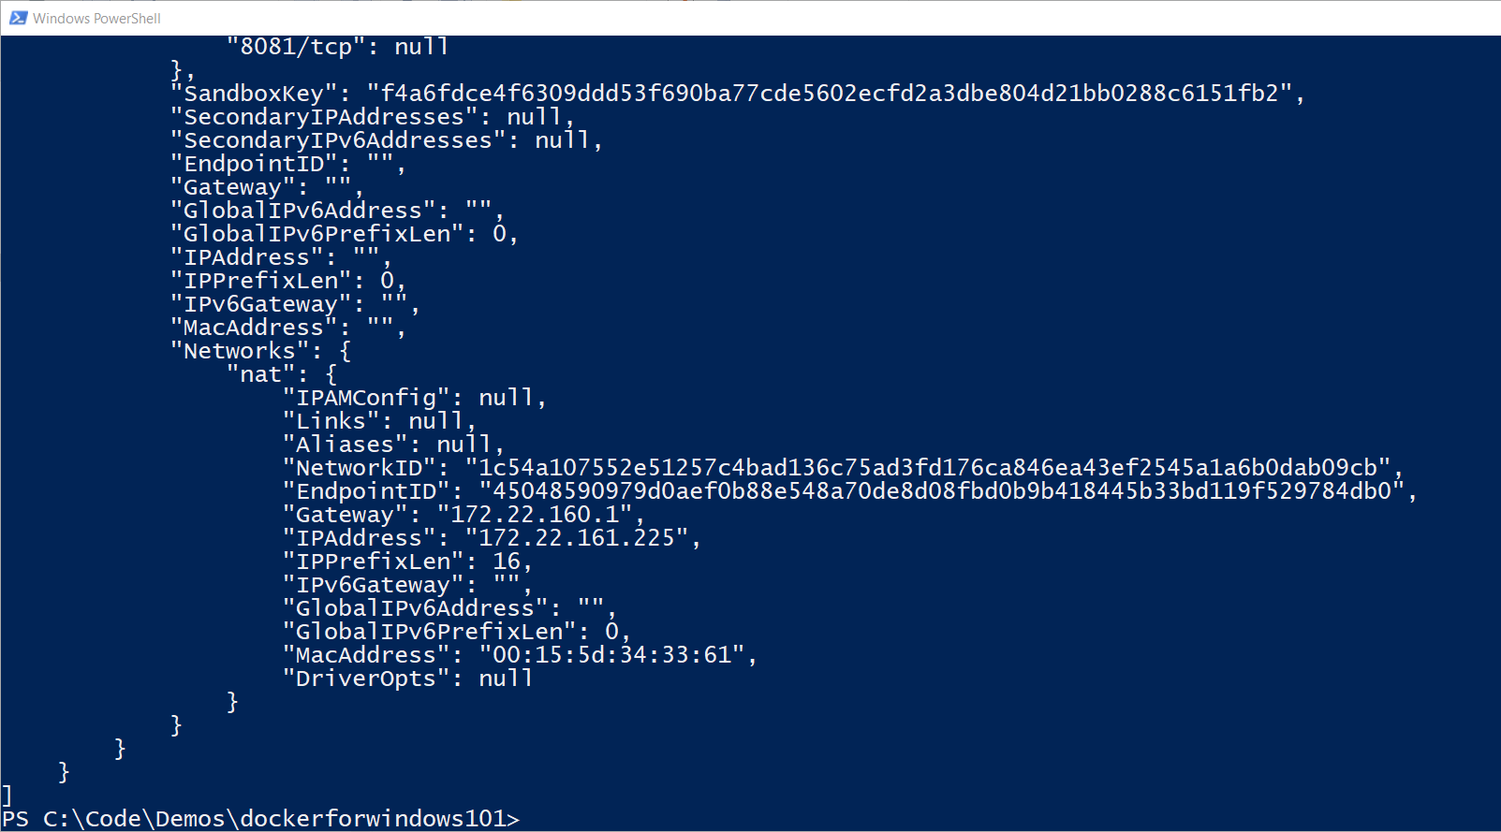

Slide 8
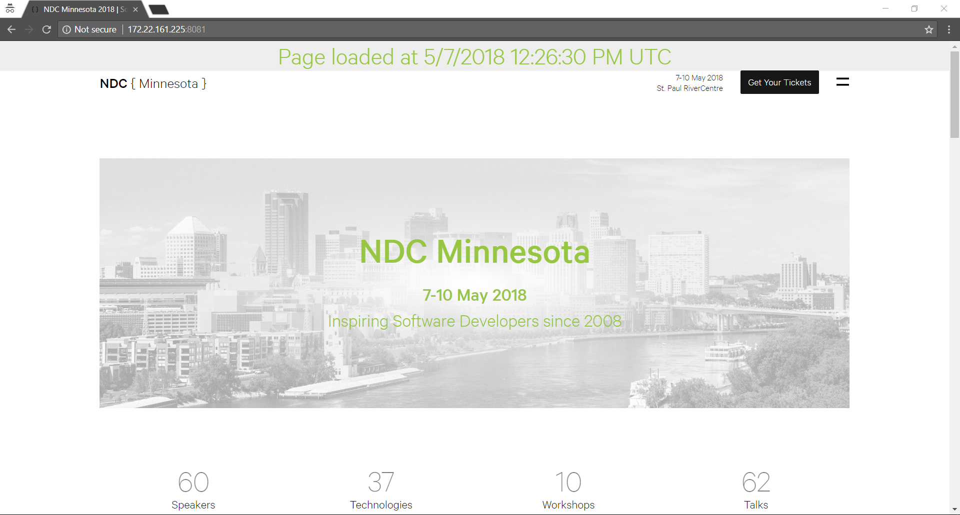

Slide 9
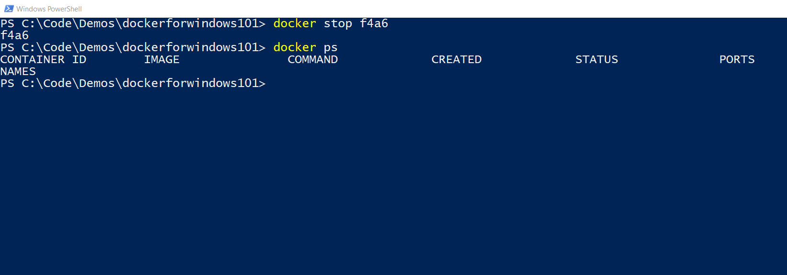

Slide 10


Slide 11


Slide 12


Slide 13
Demo 2 Packaging your .NET Core application into a container

Slide 14
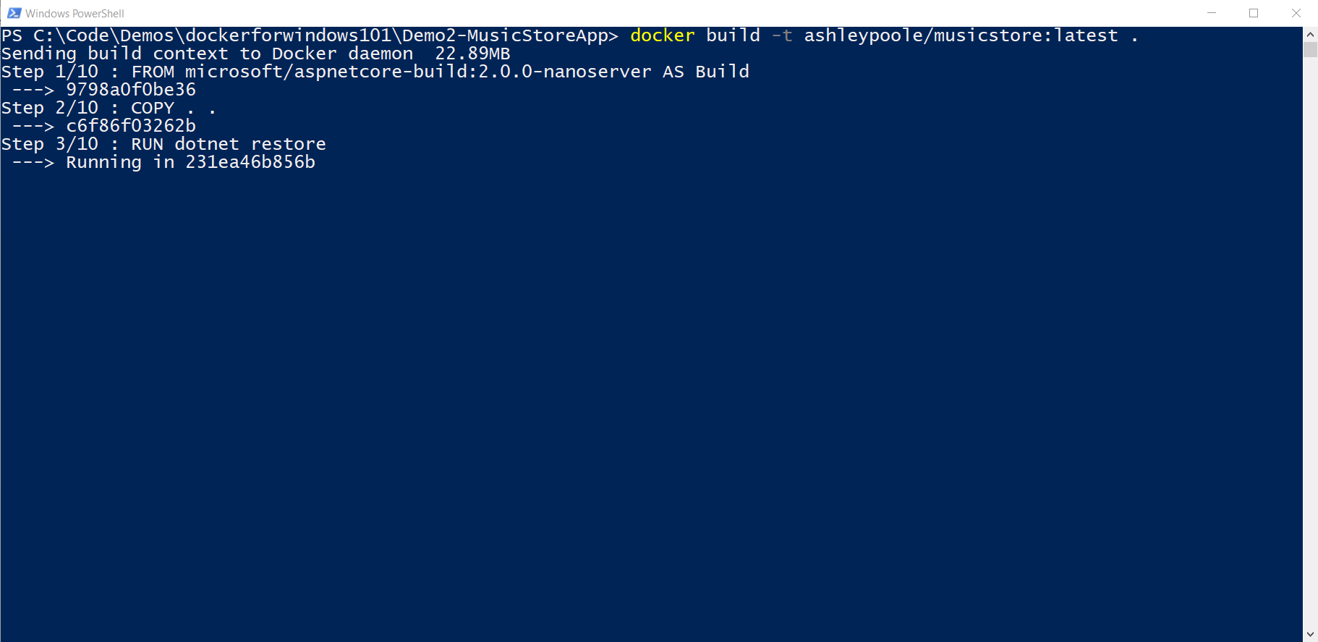

Slide 15
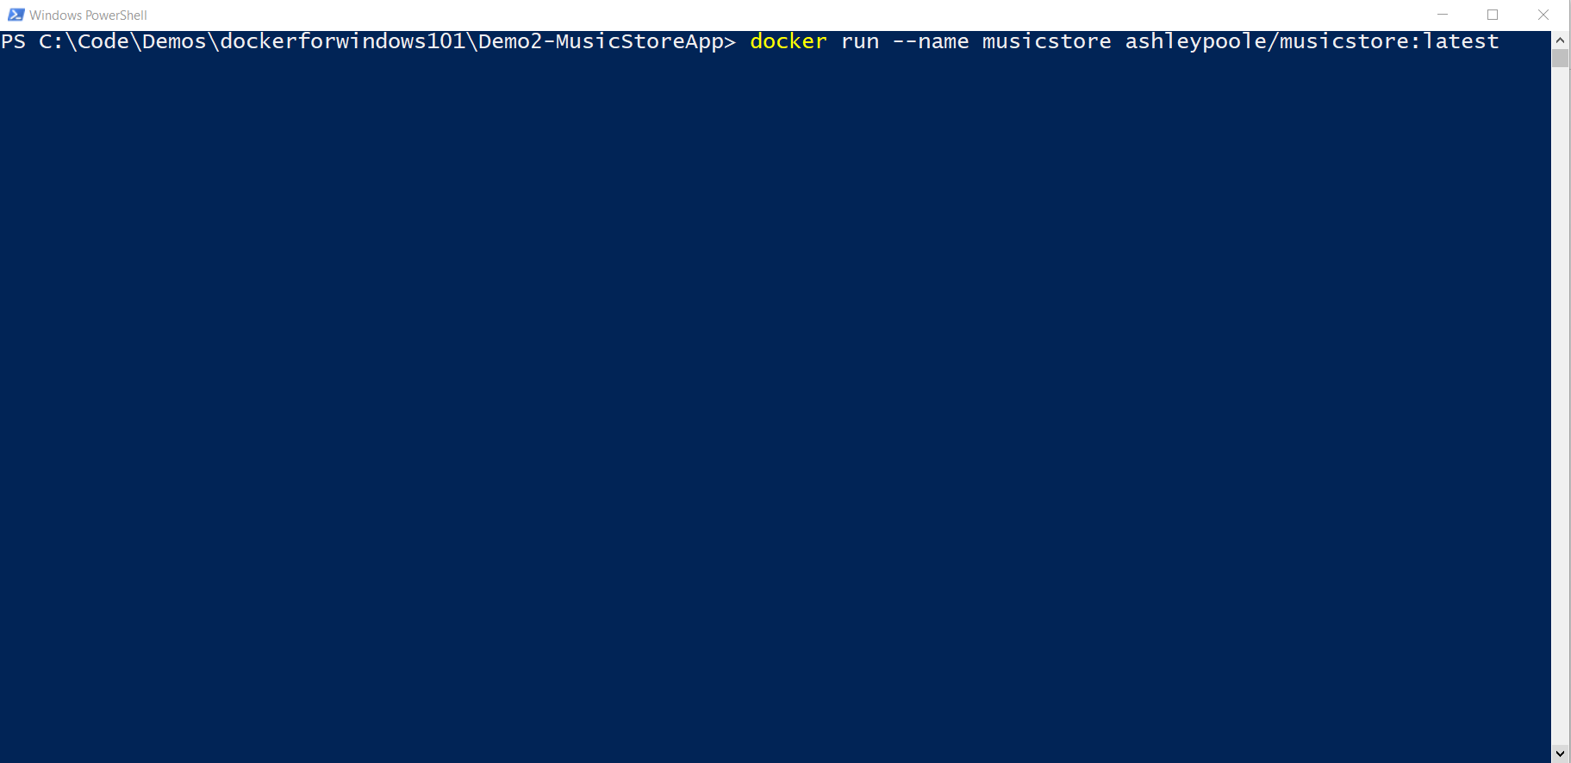

Slide 16
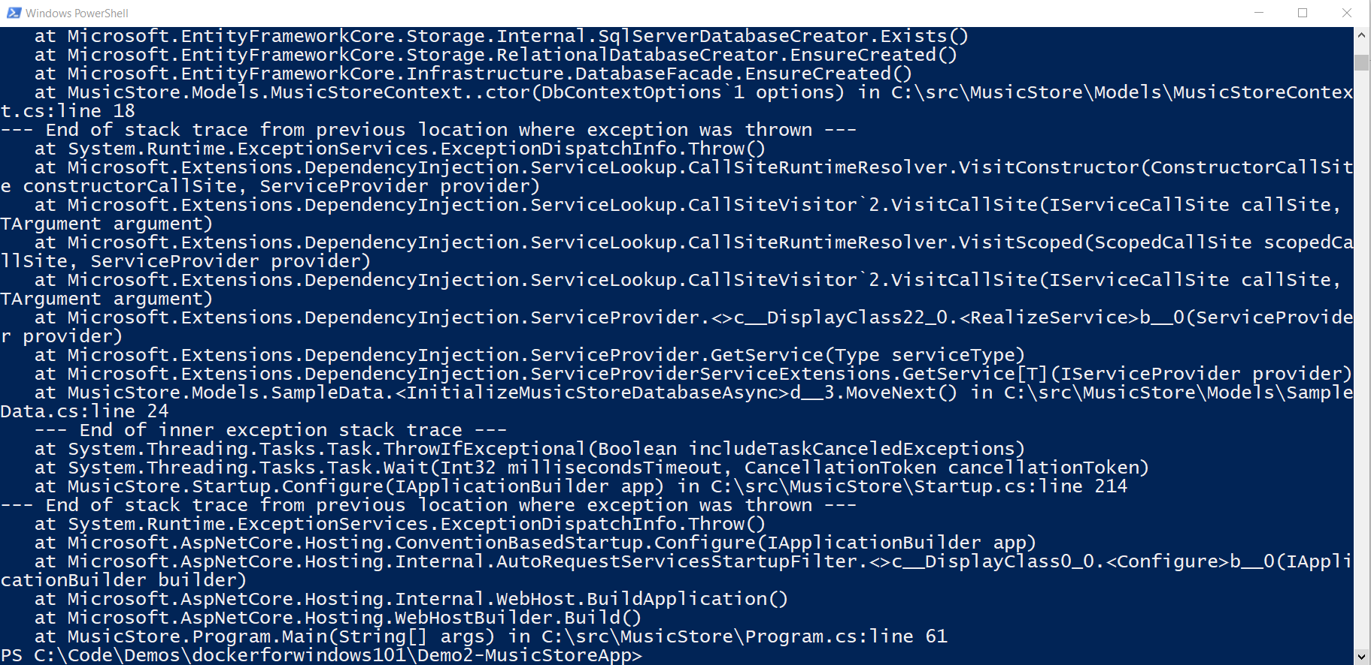

Slide 17


Slide 18


Slide 19
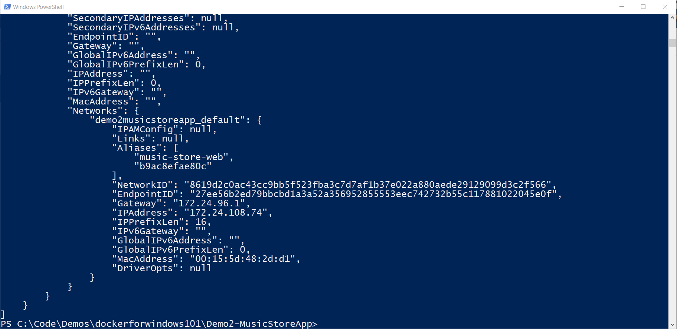

Slide 20
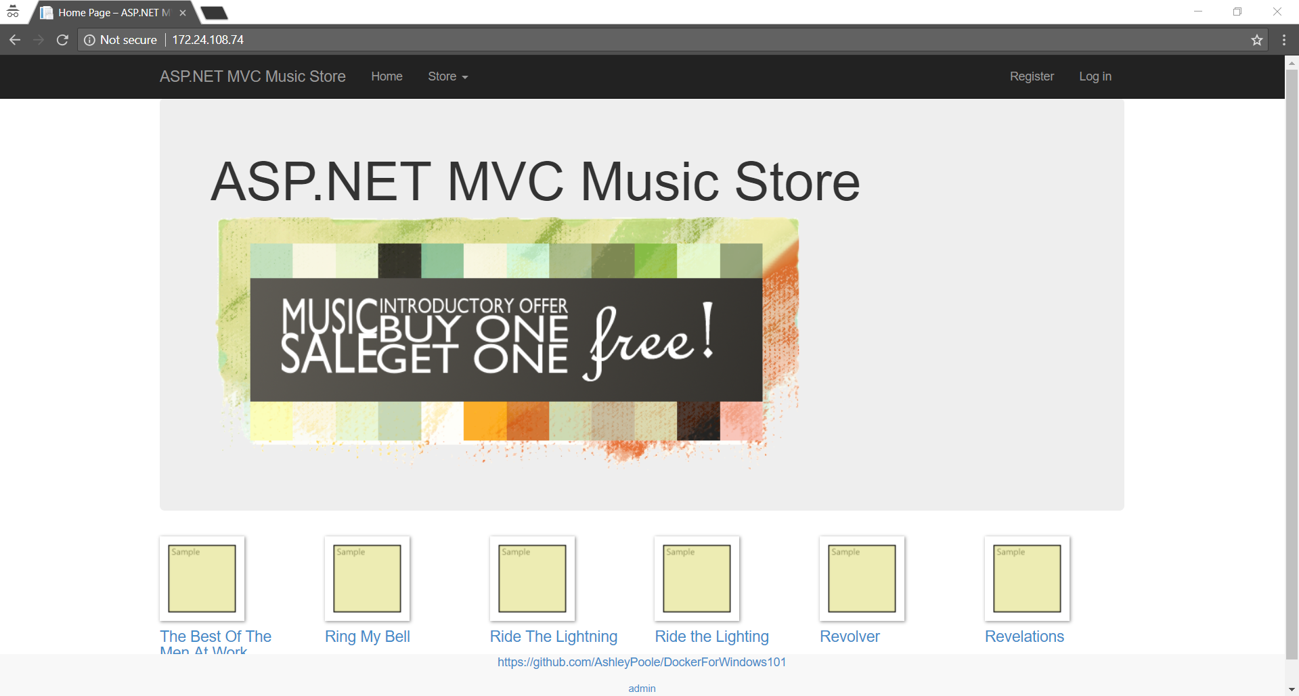

Slide 21

Demo 3 Exposing your Docker containers using Cloudflare Argo Tunnels

Slide 23


Slide 24
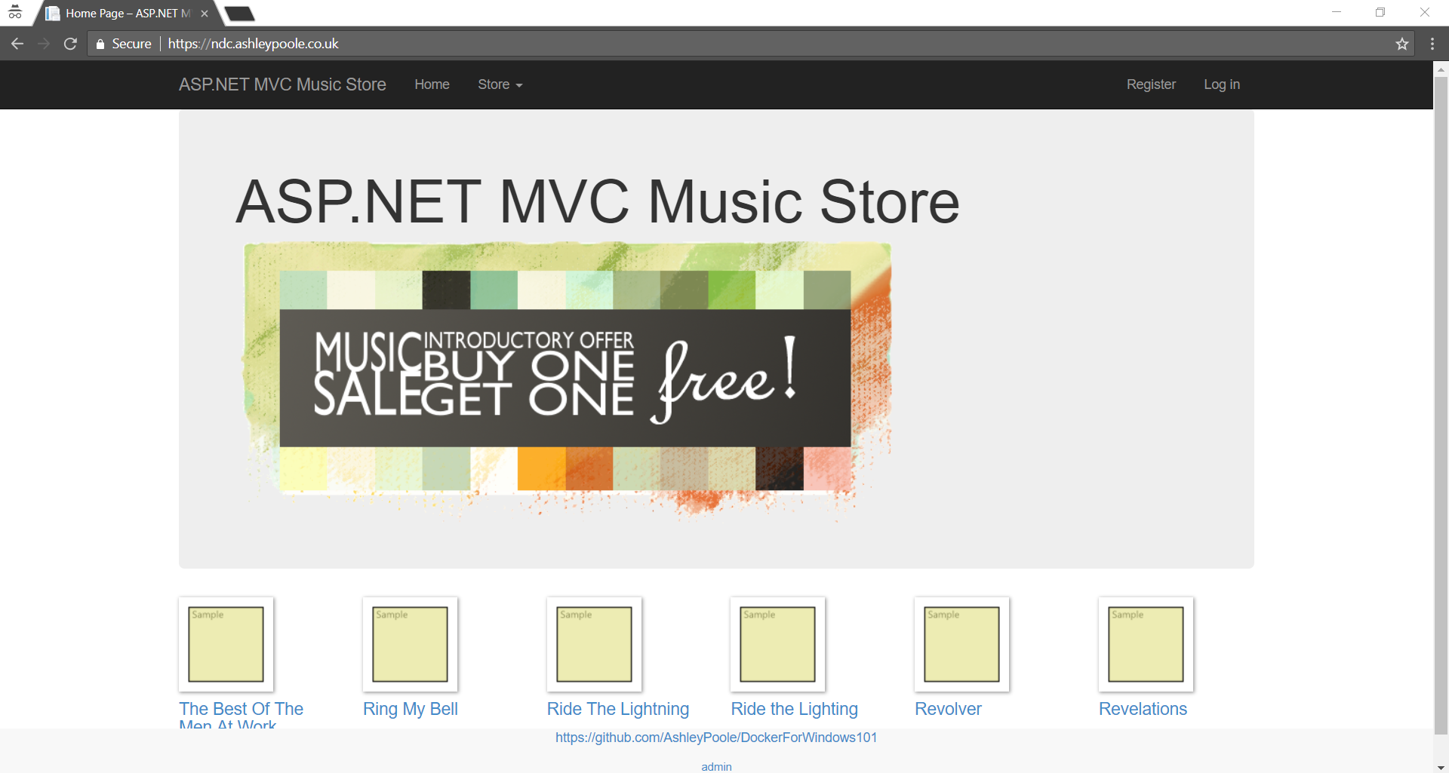

Slide 25
